Slide 1
Sales Forecasting
A Retail Sales Forecasting System
Under the Esteemed Guidance of
Ms. Prathusha ,Department of CSE,
PRESENTED BY
2420030424 M.Sahathi
2420030514 Y.Anuhya
2420030680 KANDULA NIKHIL REDDY

Slide 2
01 — PROBLEM STATEMENT
Retailers plan blind without a forecast
01
02
03
Inventory
Staffing
Promotions
Overstock ties up cash; understock loses sales — both stem from guessing next month's demand.
Store and warehouse schedules are set weeks ahead, but demand swings with seasons and promotions.
Marketing teams run sales without knowing how much lift a promotion will actually generate.
A retail store needs a way to forecast monthly sales using historical data, seasonal trends, and promotions — turning guesswork into a repeatable, data-driven process.
02

Slide 3
02 — OBJECTIVES
What the system sets out to do
1
Ingest historical sales data (date, category, units, revenue, promotion flag) from CSV uploads.
2
Identify seasonal demand patterns across months and product categories.
3
Quantify the uplift promotions create, so future campaigns can be planned with confidence.
4
Generate a month-by-month revenue forecast with a confidence range, not a single guess.
5
Let planners simulate scenarios — new promotions, marketing spend changes — before committing budget.
6
Export forecasts as shareable reports for inventory, staffing, and marketing teams.
03

Slide 4
03 — METHODOLOGY
From raw data to a forecast
01
02
03
04
Collect
Decompose
Adjust
Project
Historical monthly sales by category: units, revenue, and a promotion flag.
→
Separate the series into trend (linear regression) and seasonality (monthly index vs. yearly average).
→
Apply a promotion uplift factor to months with planned or historical promotions.
→
Combine trend × seasonal index × promotion factor to forecast 3–12 months ahead, with a confidence band.
Model: Seasonal Decomposition + Linear Trend, with a promotion multiplier applied per month.
04

Slide 5
04 — SYSTEM DESIGN
Architecture & tech stack
CSV Upload
Data Aggregation
Forecast Engine
Dashboard & Charts
→
→
→
Frontend
HTML5, CSS3, JavaScript (ES6)
Visualization
Chart.js — bar, line, and doughnut charts
Forecasting logic
Client-side time-series model (trend + seasonal index)
Optional backend
Python (Flask/FastAPI) for ARIMA/Prophet-based forecasting
Data format
CSV in, CSV/PDF reports out
05

Slide 6
05 — KEY FEATURES
Inside the application
Dashboard
Data Upload
Forecast Engine
Revenue, growth, and top-category KPIs at a glance, with 24-month history and seasonal index charts.
Drag-and-drop CSV ingestion of historical sales — date, category, units, revenue, promotions.
Projects 3, 6, or 12 months ahead with adjustable promotion-boost assumptions and confidence bands.
Scenario Simulator
Reports
Clean Dashboard UI
Test 'what-if' promotions or marketing spend changes against the baseline forecast instantly.
Export forecast tables as CSV, or print a polished summary as PDF.
Card-based layout with a dedicated nav for Dashboard, Upload, Forecast, Scenarios, and Reports.
06

Slide 7
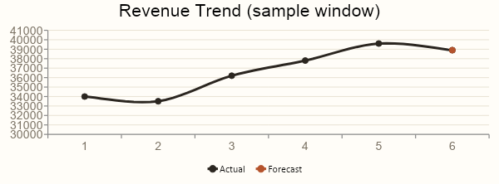
06 — RESULTS
What the forecast predicts
$987,420
+12.4%
±8%
$245K
24-month historical revenue
Year-over-year growth
Forecast confidence band
Projected next 6 months
Promotional months (Nov–Dec) show the largest seasonal index and the highest forecast uplift — guiding where to plan inventory and staffing first.
07

Slide 8
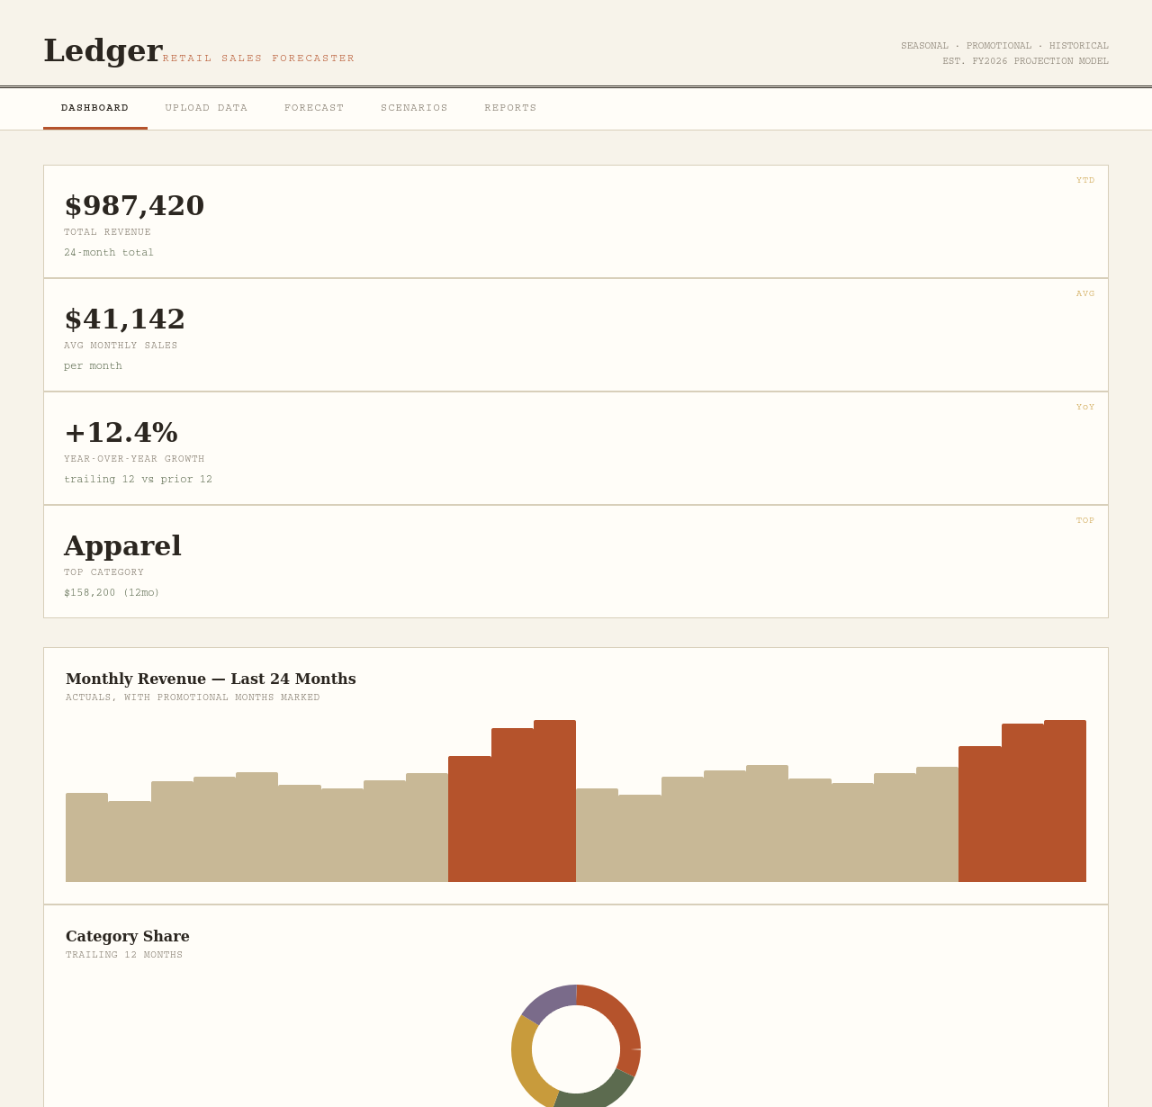
Dashboard view
08

Slide 9
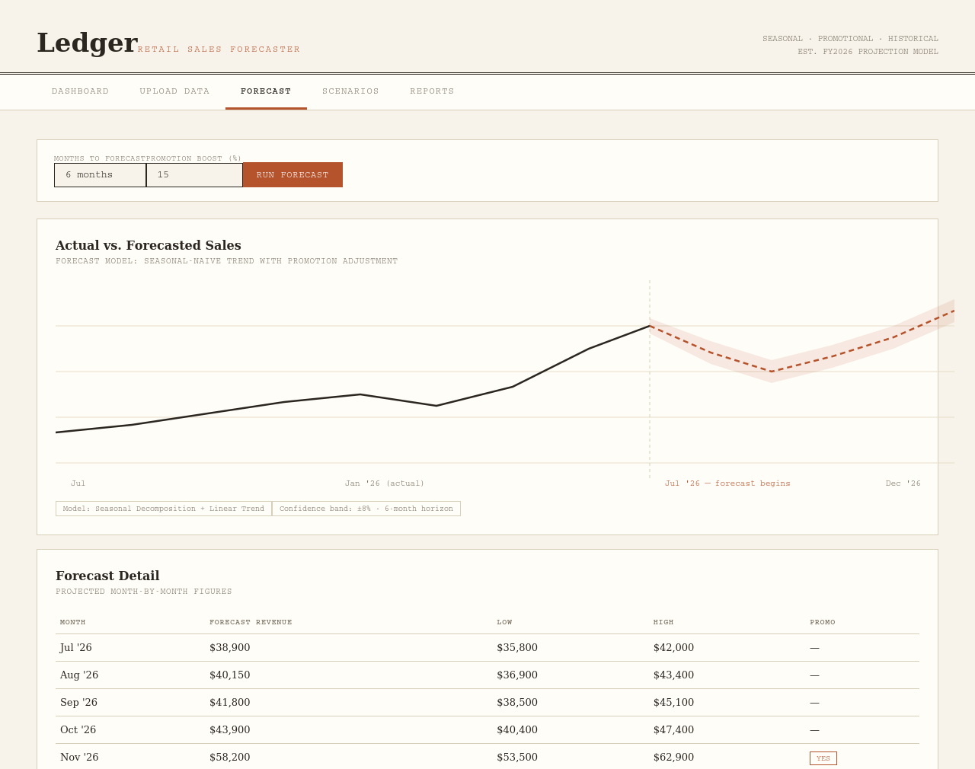
Forecast view
09

Slide 10
08 — CONCLUSION
Forecasting turns history into a plan
By combining historical trends, seasonal patterns, and promotion data, the system gives a retail store a defensible monthly forecast — not a guess.
Next steps: connect to live POS data, add ARIMA/Prophet for longer horizons, and extend scenario simulation to multi-store comparisons.
THANK YOU

